Slide 1
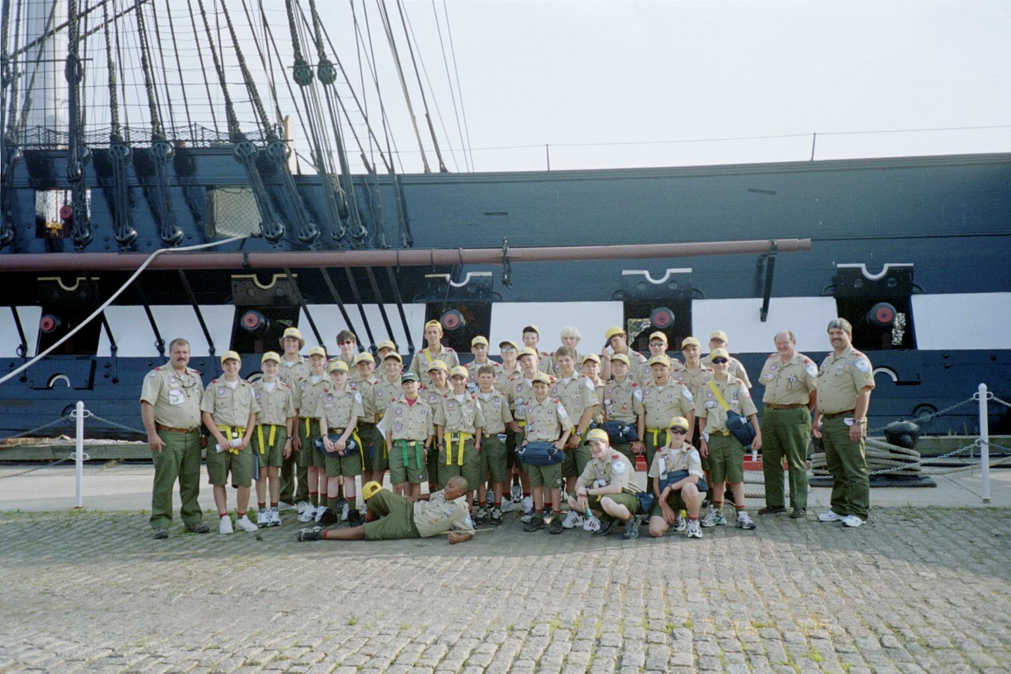
THIS COULD BE YOU

Slide 2
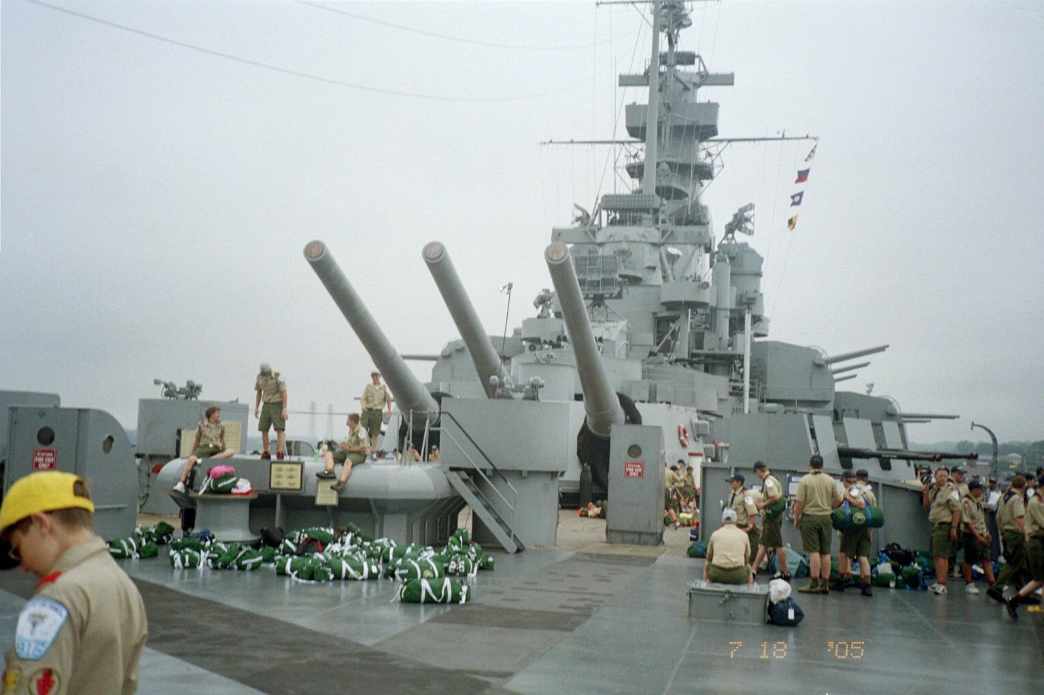
Ever dream of sleeping on a battleship?

Slide 3
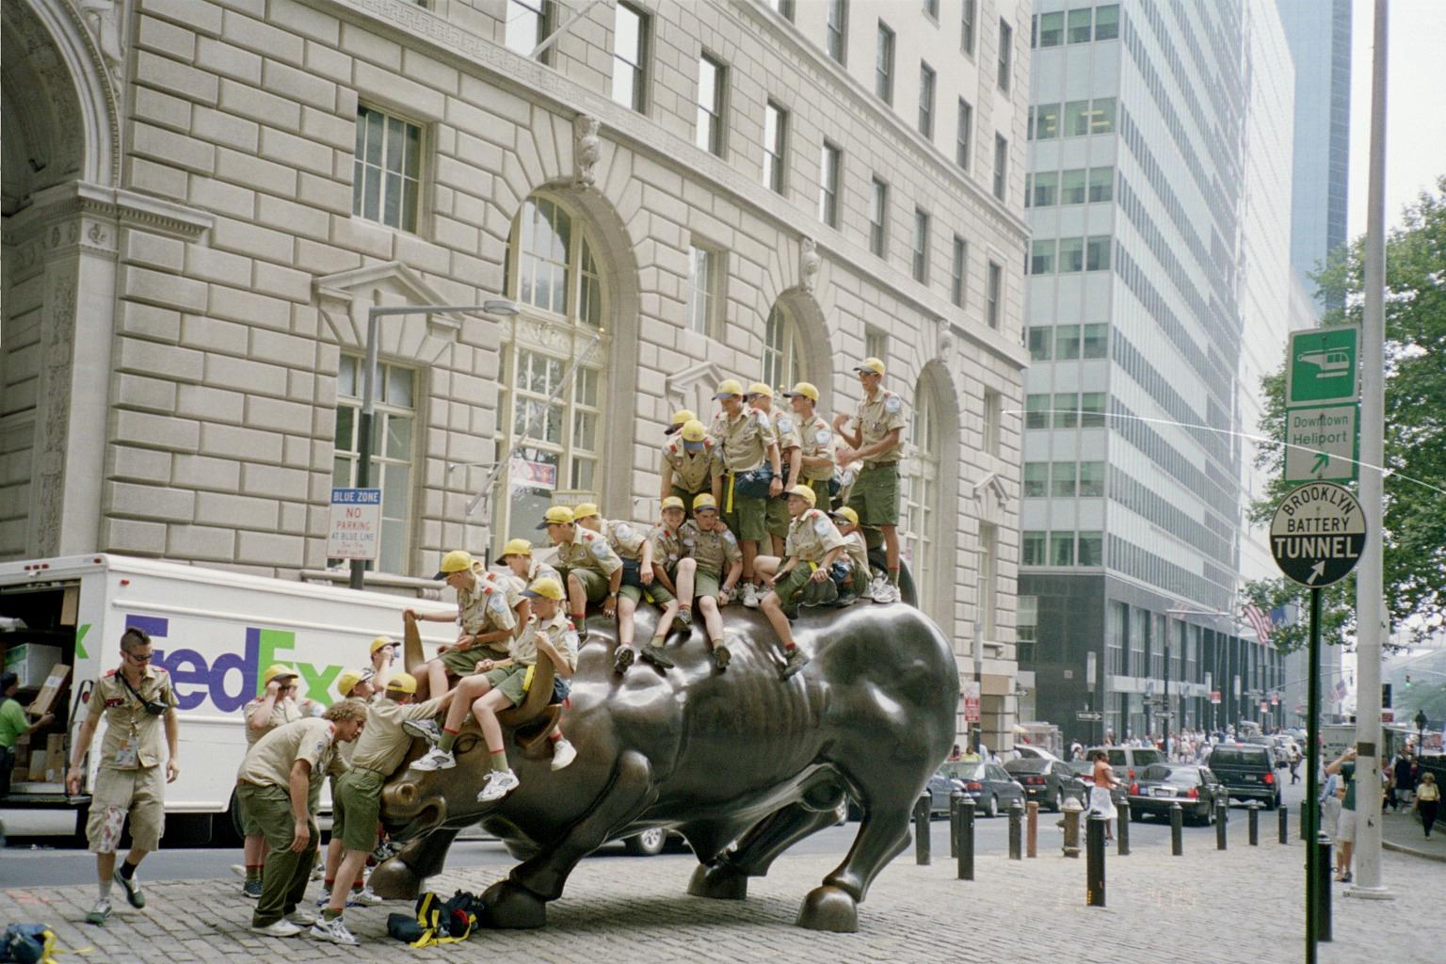
TRY YOUR HAND AT BULL RIDDING

Slide 4
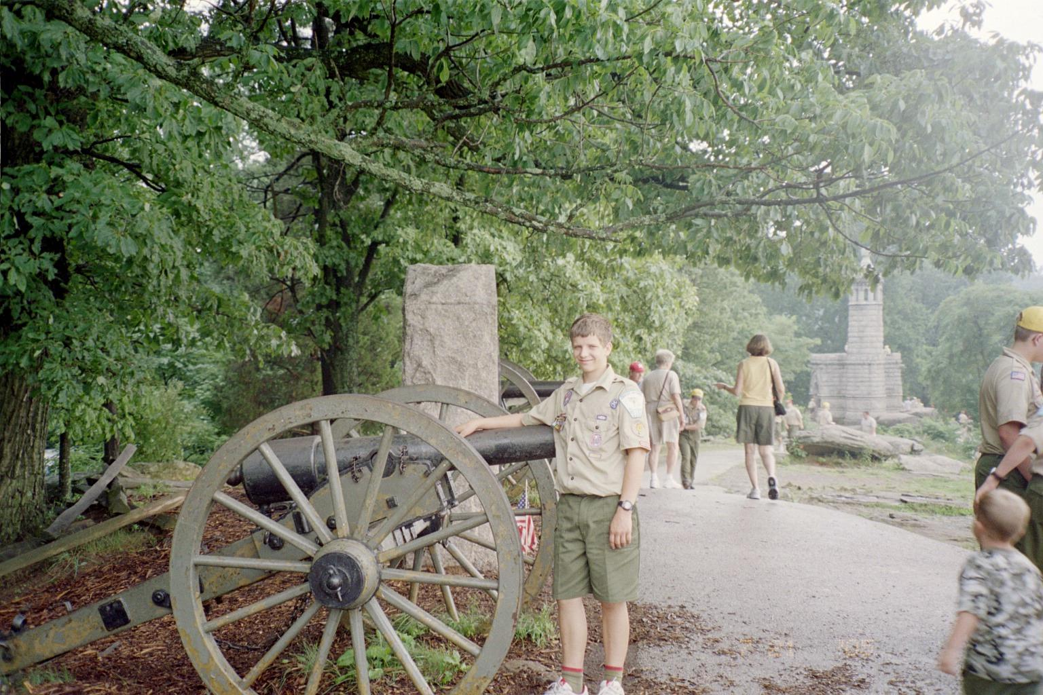
Relive history

Slide 5
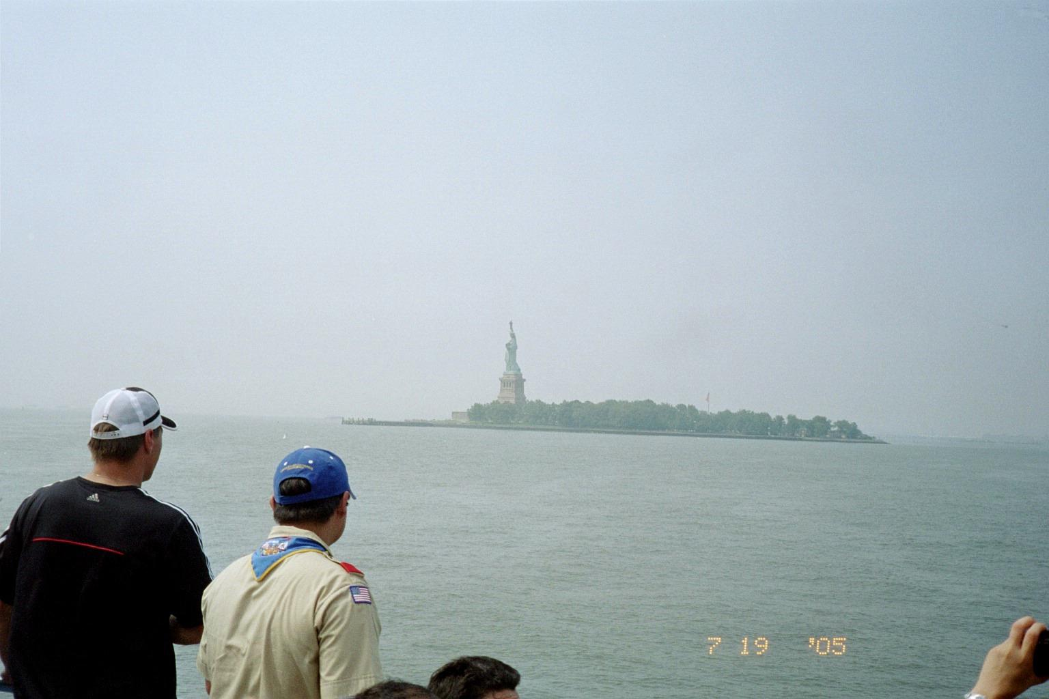
VISIT LADY LIBERTY

Slide 6
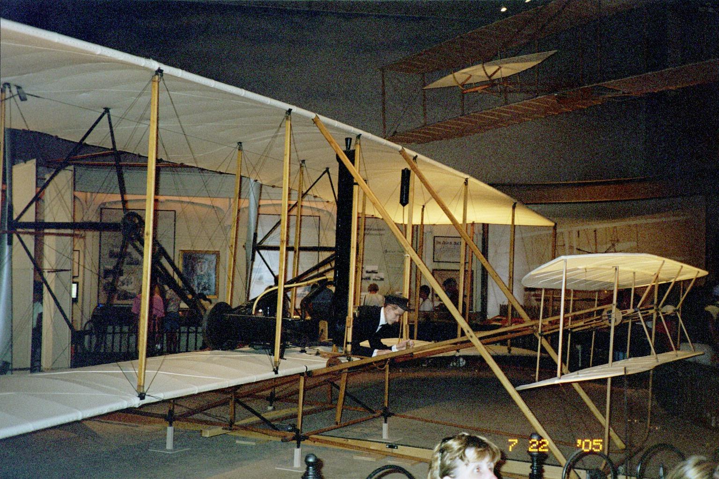
GET HERE ANY WAY YOU CAN

Slide 7
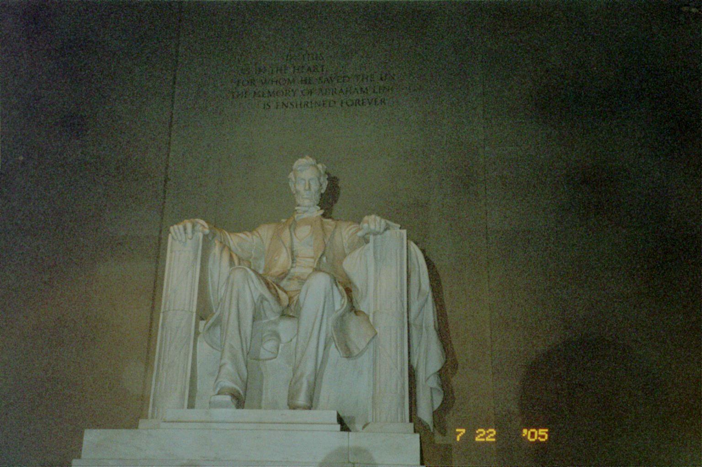
VISIT THE GREAT ONES

Slide 8
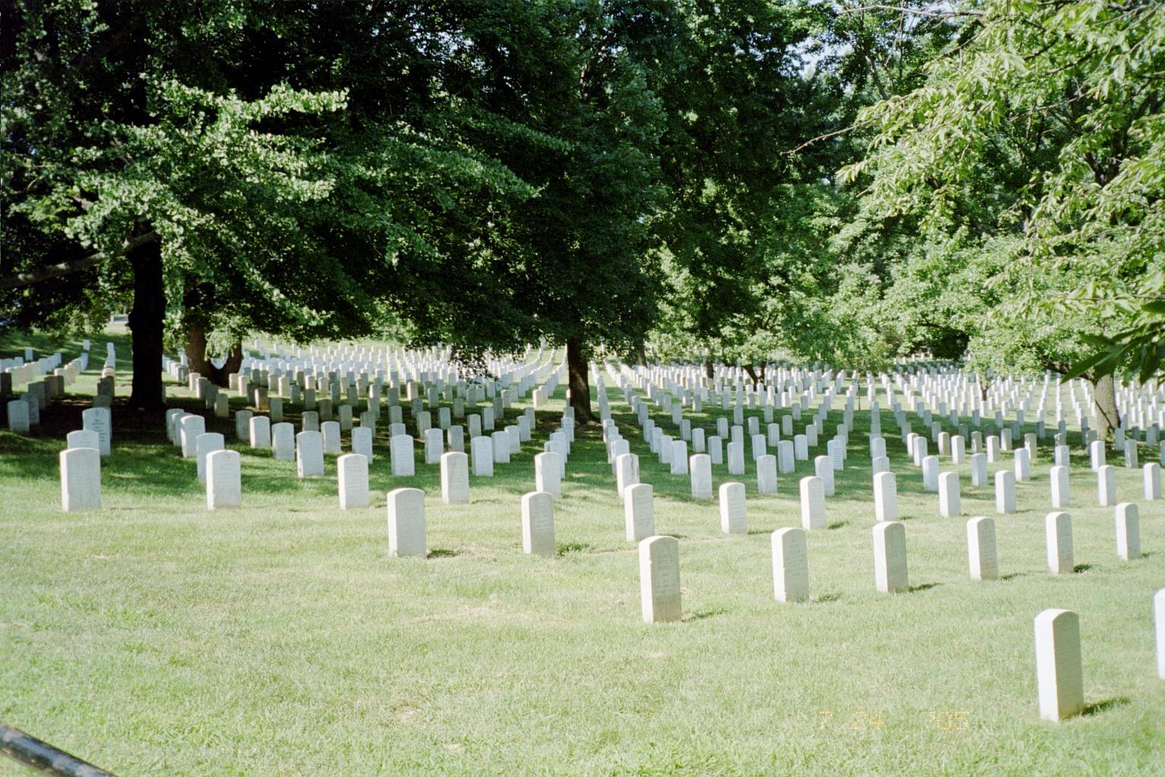
PAUSE TO REMEMBER

Slide 9
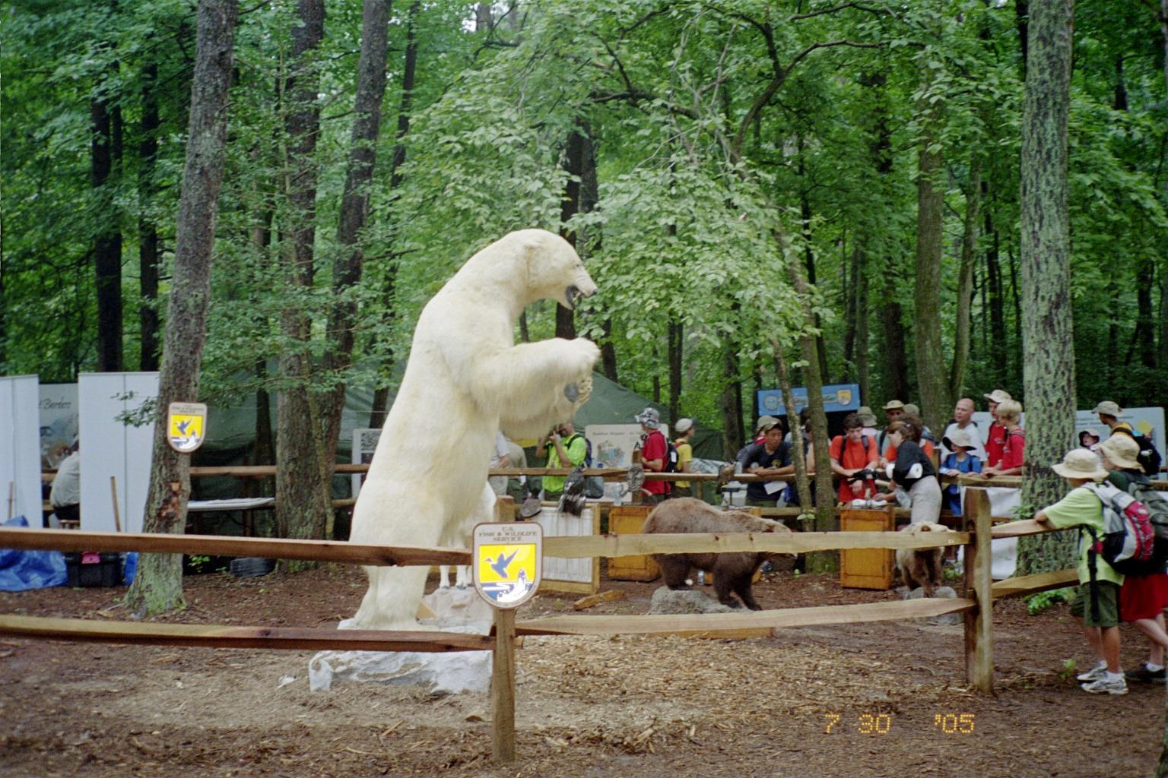
LEARN ABOUT YOUR WORLD

Slide 10
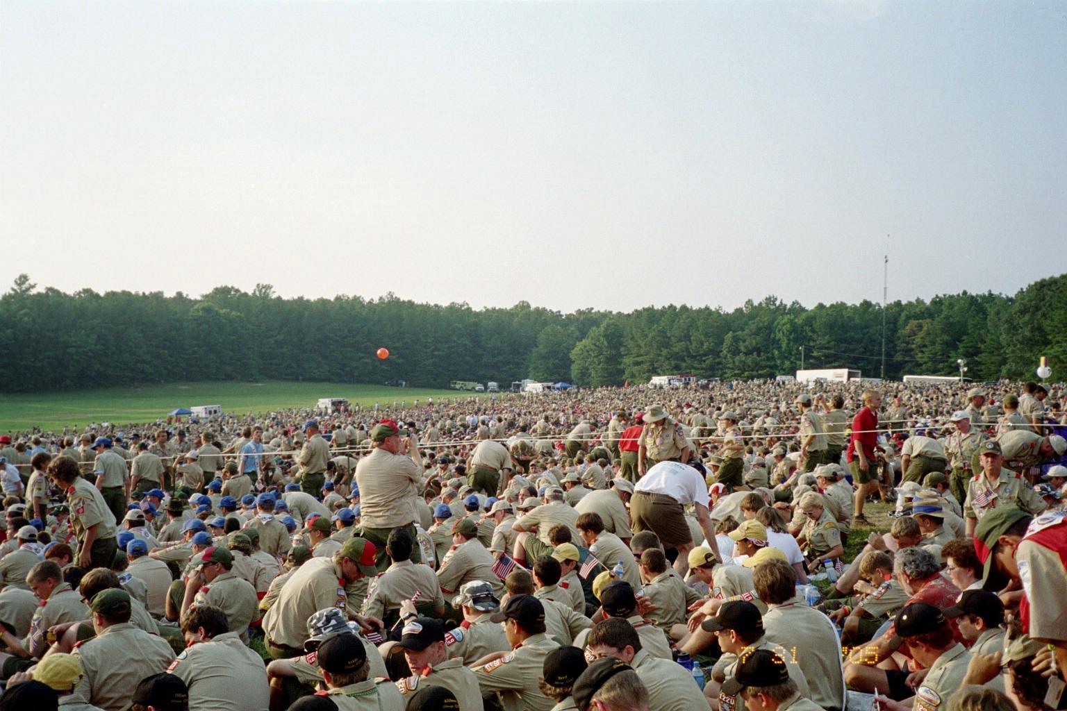
MEET NEW PEOPLE

Slide 11
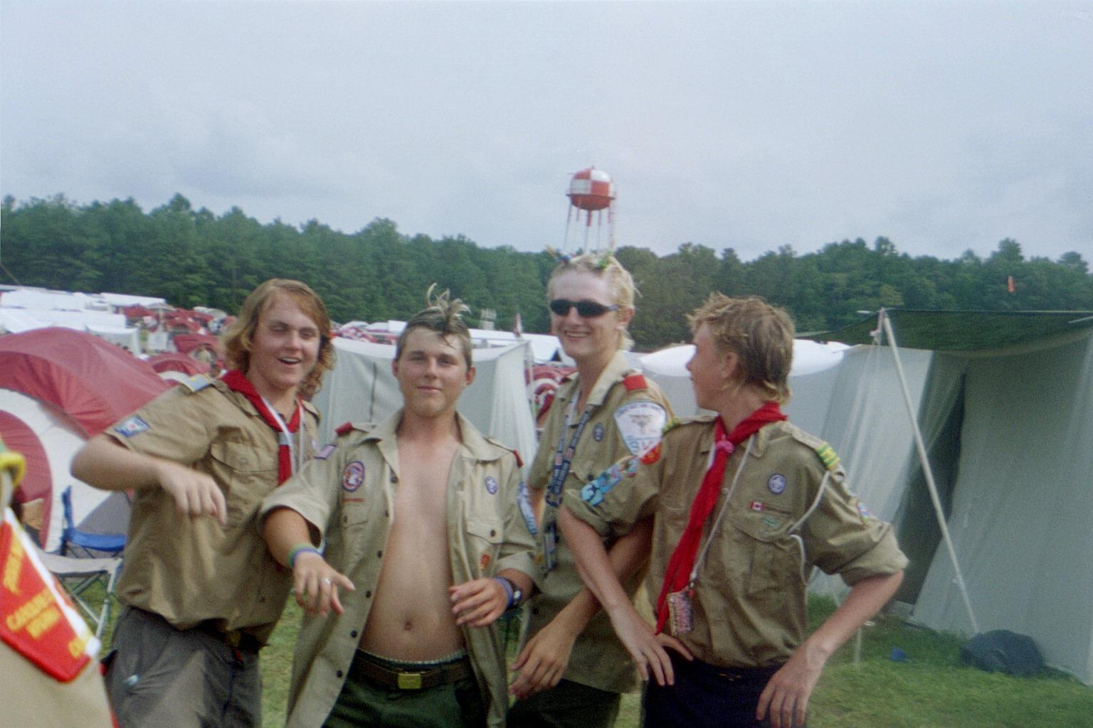
MAKE SOME NEW FRIENDS

Slide 12
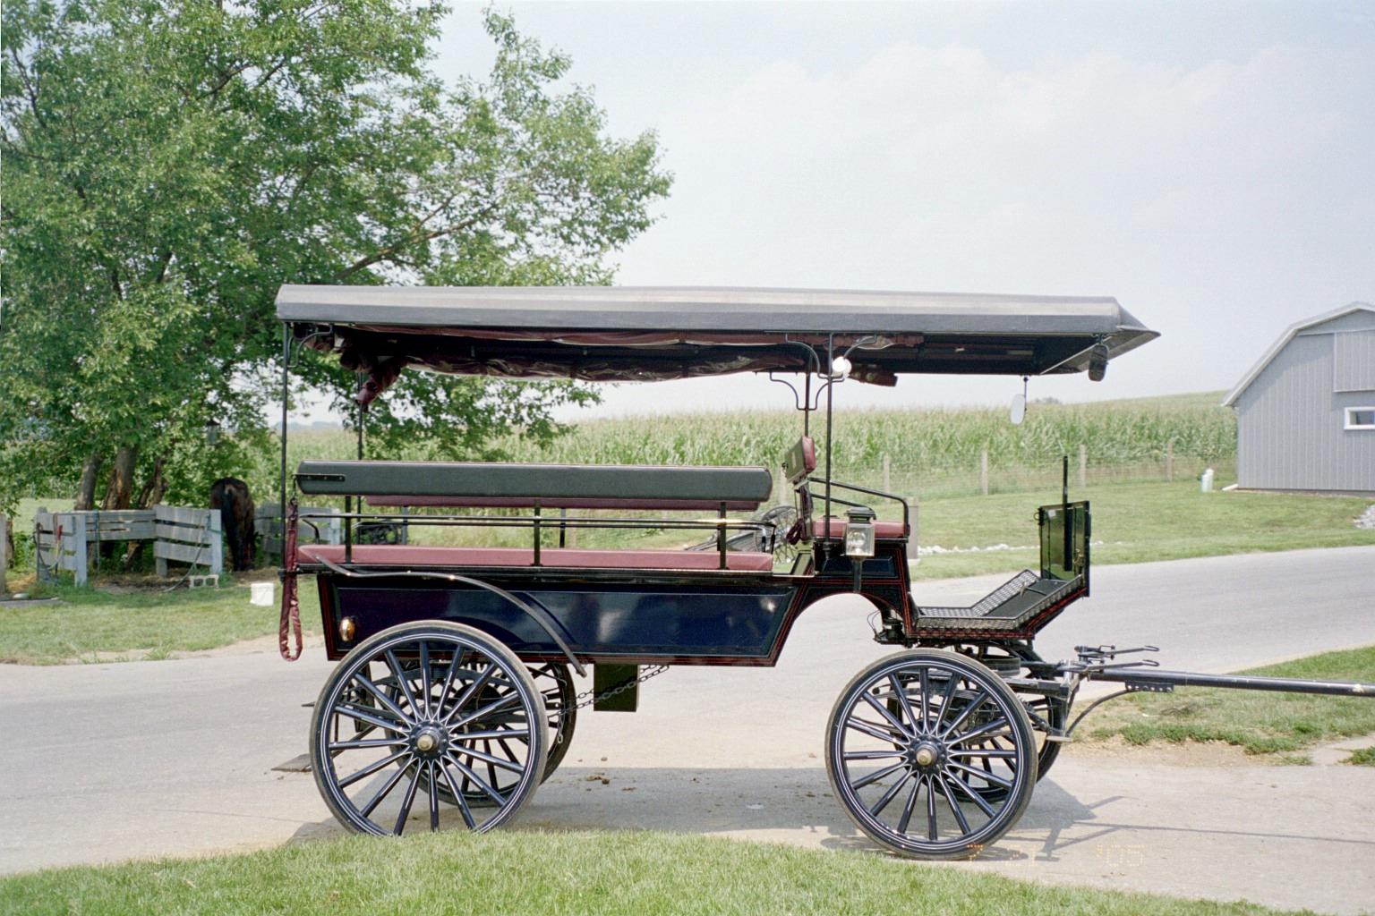
HITCH UP THE BUGGY

Slide 13
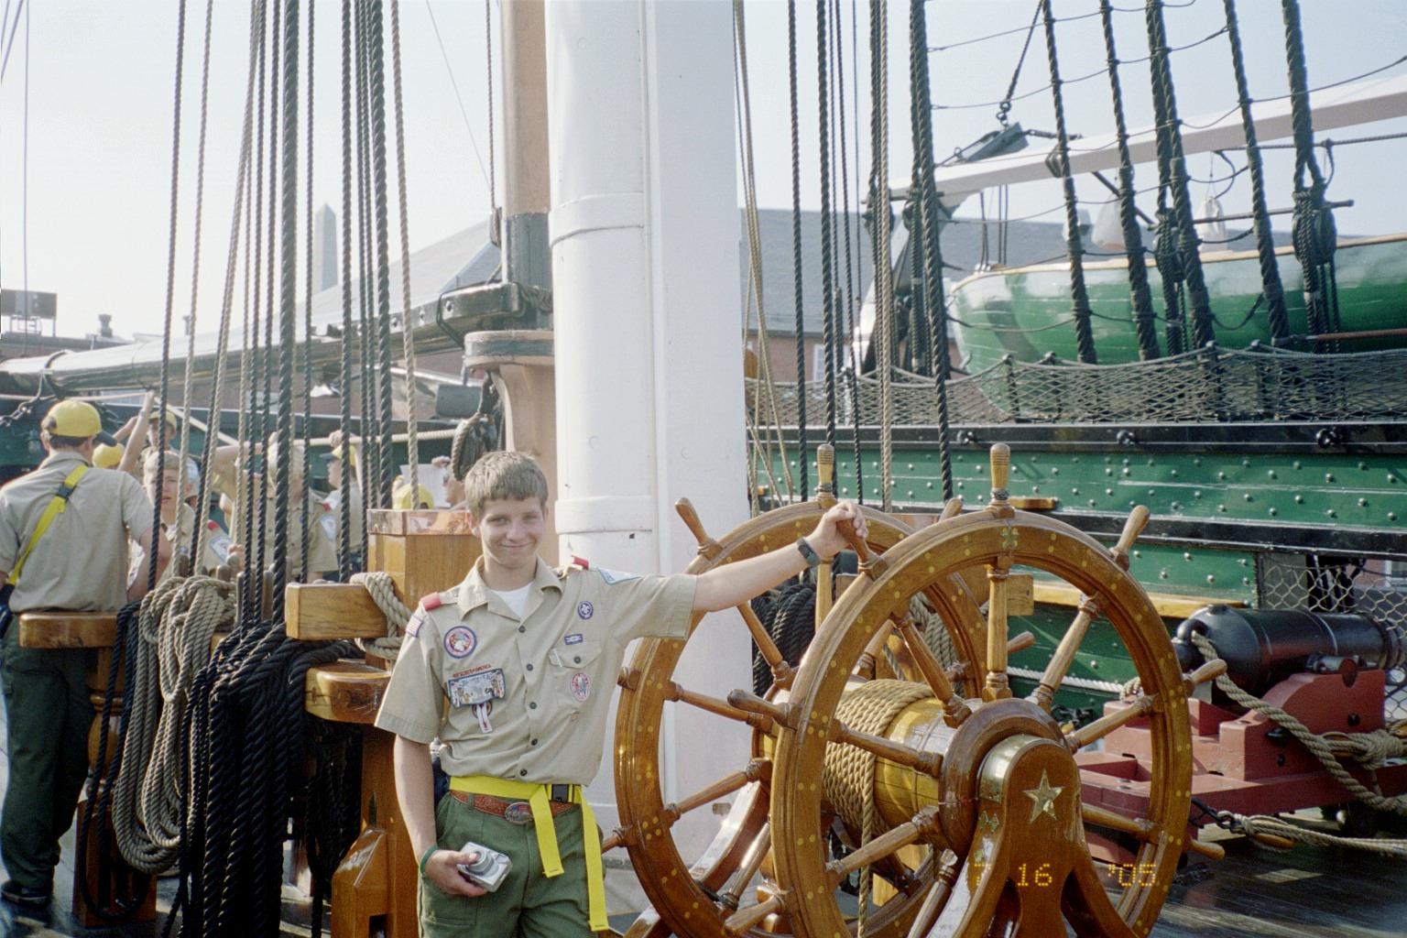
SET YOUR COURSE

Slide 14
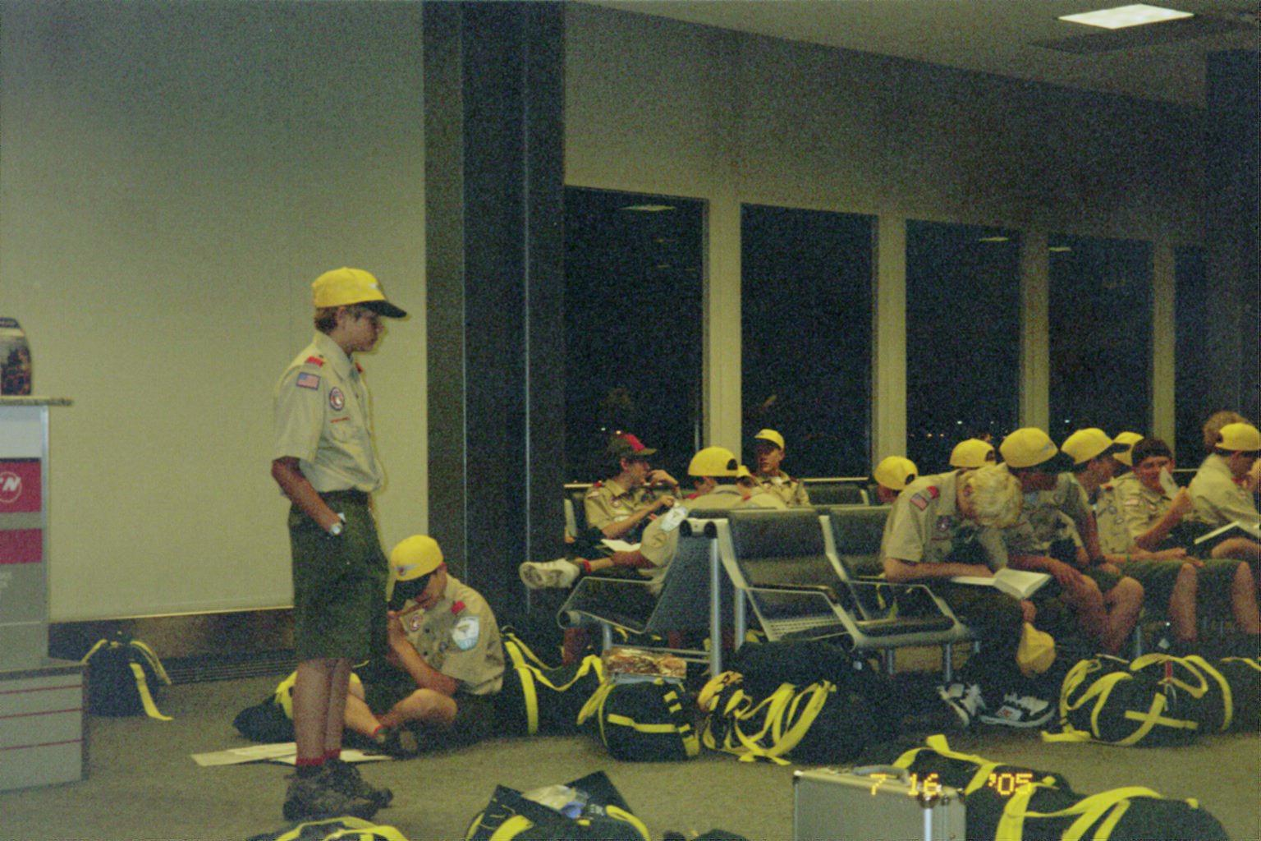
GET YOUR FRIENDS TOGETHER

Slide 15
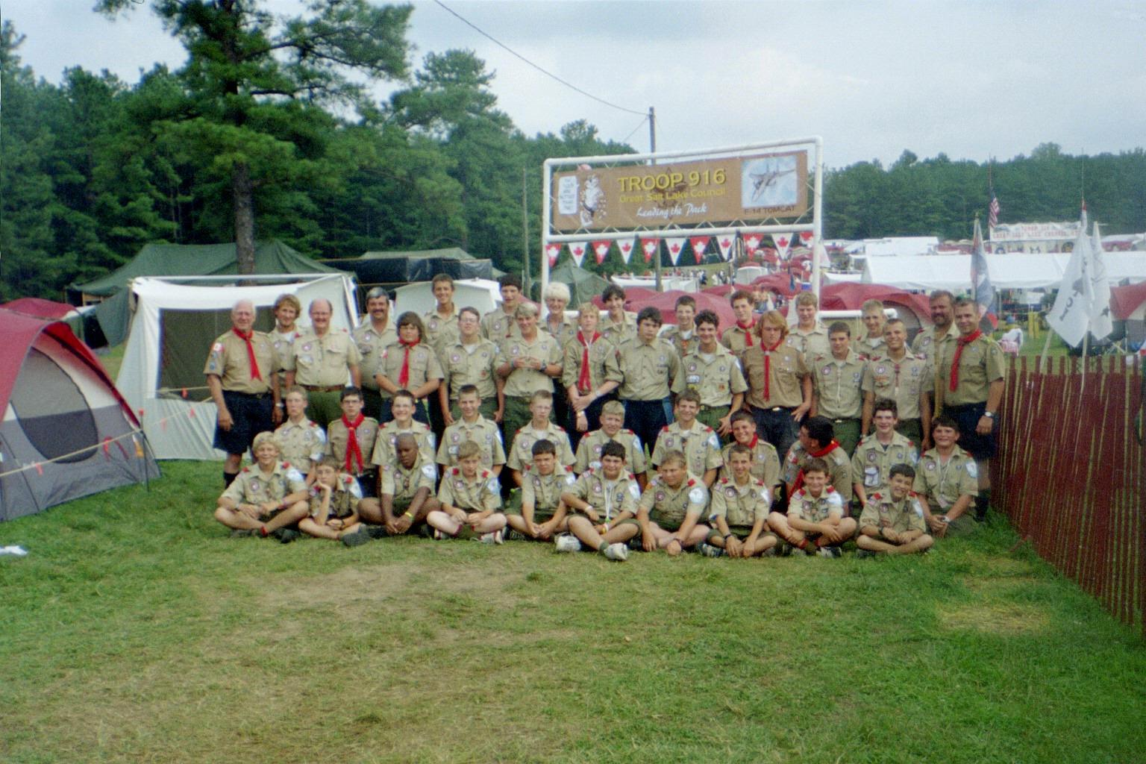
MEET US AT THE HILL
JOIN US AT THE 2010 JAMBOREE

Slide 16
QUESTIONS? INTERESTED?
For more information
Calvin Engh at calengh@yahoo.com
Check with your local Scout Shop
Look on the Council web site www.gslc.bsa.org

